Slide 1
TCP/IP connectivity using netcat
Mehul | Akash | Paras

Slide 2
Introduction
Netcat referred to as a Swiss army knife of networking tools, this versatile command can assist you in monitoring, testing, and sending data across network connections.

Slide 3
General Syntax
By default, netcat operates by initiating a TCP connection to a remote host.
The most basic syntax is:
$nc [options] host port
This will attempt to initiate a TCP to the defined host on the port number specified.

Slide 4
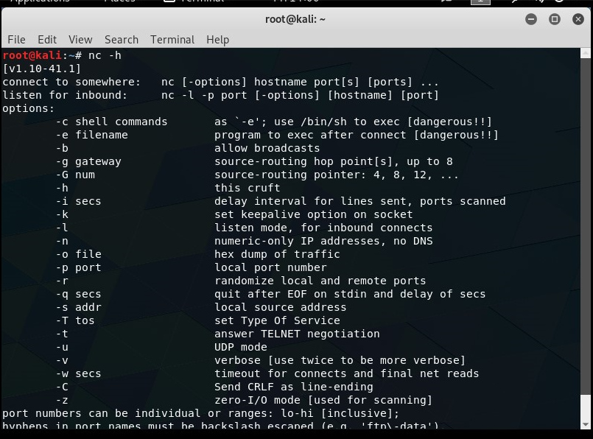

Slide 5
Communicate through Netcat
Netcat is not restricted to sending TCP packets. It also can listen on a port for connections and packets.
This gives us the opportunity to connect two instances of netcat in a client-server relationship.
Which computer is the server and which is the client is only a relevant distinction during the initial configuration.
After the connection is established, communication is exactly the same in both directions.
On one machine, you can tell netcat to listen to a specific port for connections. We can do this by providing the –l parameter and choosing a port:

Slide 6
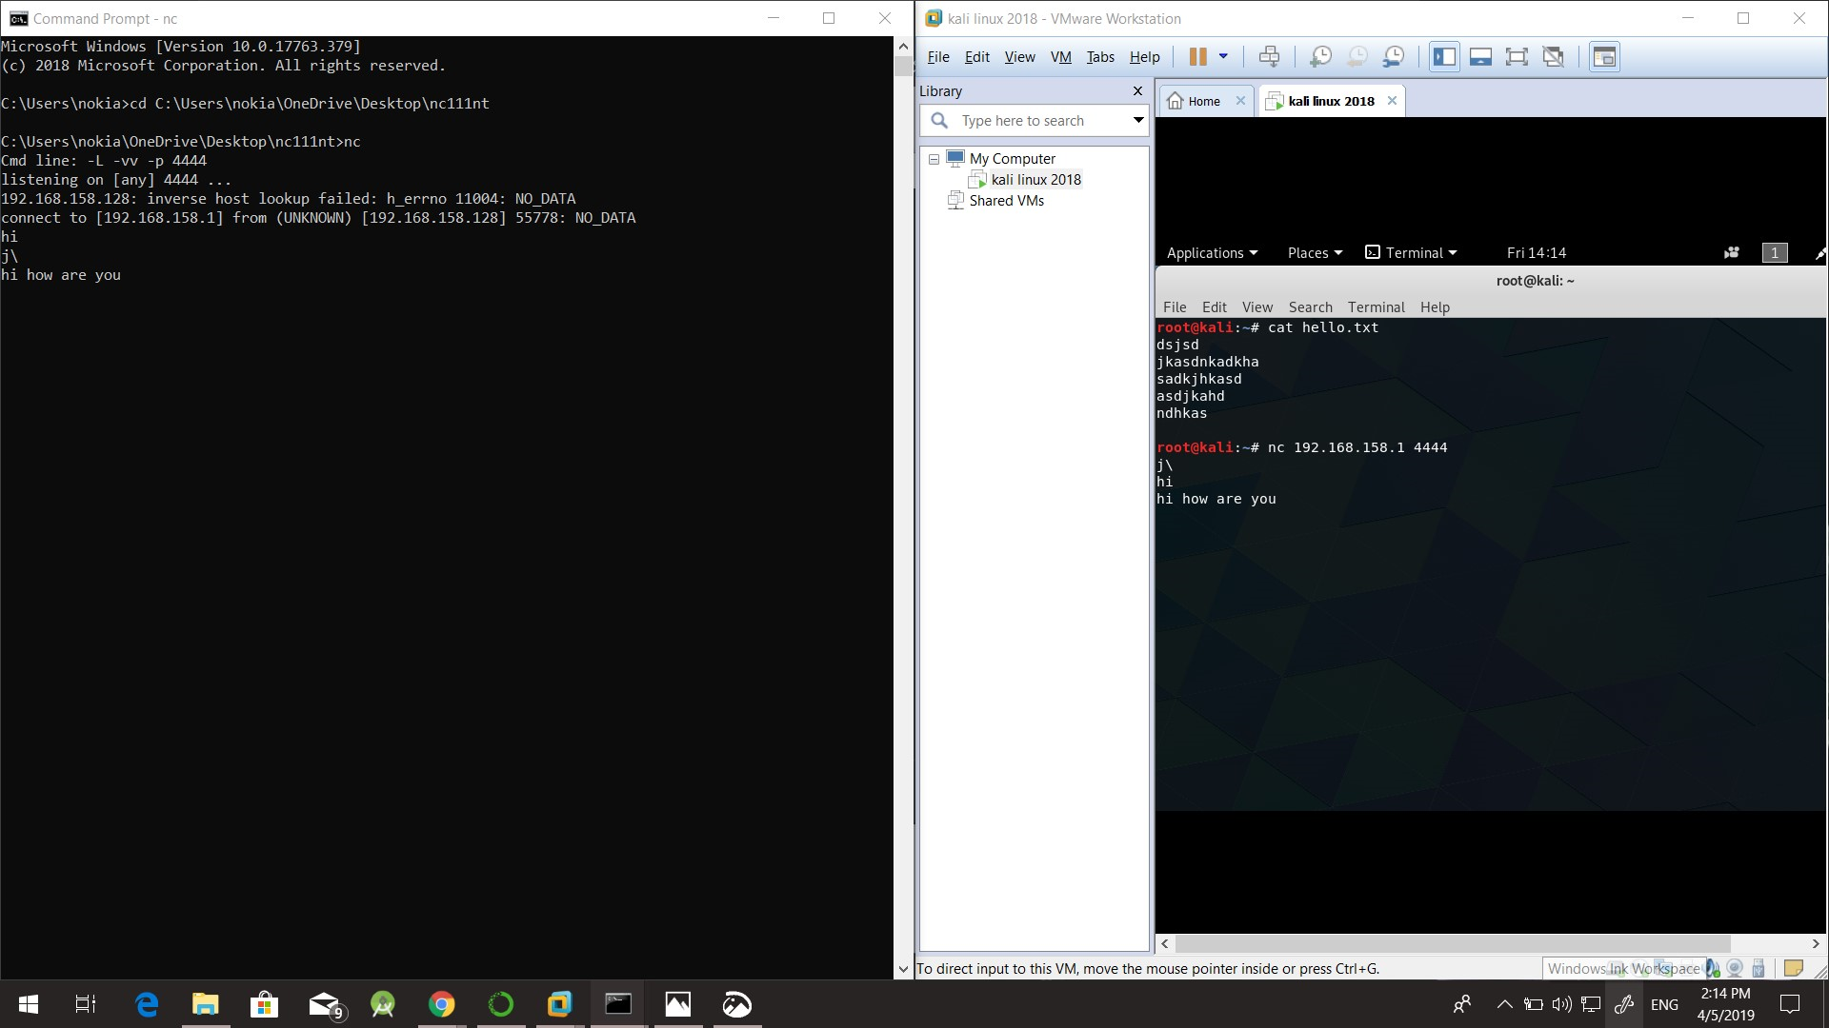
CMD line: -L –vv –p 4444

Slide 7
This will tell netcat to listen for TCP connections on port 4444. As a regular (non-root) user, you will not be able to open any ports under 1000, as a security measure.
On a second server, we can connect to the first machine on the port number we choose. We do this the same way we've been establishing connections previously:
$nc 192.168.158.1 4444

Slide 9
Send Files through Netcat (Server Side)
we are establishing a regular TCP connection, we can transmit just about any kind of information over that connection. It is not limited to chat messages that are typed in by a user. We can use this knowledge to turn netcat into a file transfer program.
$nc –v –w 30 –p 43819 –l < hello.txt
-v = verbose {its provide more information from the command on the screen}
-w 30= W means waiting and 30 means wait for a two second
-p = local port
-l = listing port mode

Slide 10


Slide 11
Send Files through Netcat (Client Side)
After sending a file from Server side we can get file using this command
$nc –v –w 2 192.168.158.128 43819 > hello.txt
-v = verbose {its provide more information from the command on the screen}
-w 2= W means waiting and 2 means wait fro a two second

Slide 12


Slide 13
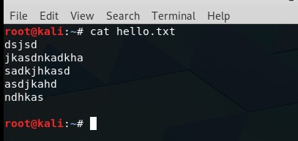
We can see on the computer that was awaiting a connection, that we now have a new file called “hello.txt" with the contents of the file we typed on the other computer:
$cat hello.txt

